Slide 1
VIRAL CORNEAL ULCER
Dr. SANJEEV kumar
Professor
Department OF ophthalmology
SKMCH, muzaffarpur

Slide 2
Definition
A breach in the normal epithelium of the cornea associated with the necrosis of the normal surrounding tissue

Slide 3
Herpes simplex keratitis
Herpes simplex viral infection of the cornea
Dendritic ulcer – Classic feature of epithelial disease
Focal endothelitis(disciform keratitis) – Classic feature of stromal disease

Slide 4
Associated features with Hsv keratitis
Underlying keratic precipitates
Increased intraocular pressure from associated trabeculitis

Slide 5
epidemiology
Human herpesviruses have in common a state called latency where the virus remains dormant in cells and periodically reactivates
HSV – 1 and HSV – 2 have an affinity for sensory ganglia cells
HSV – 1 and HSV – 2 are called neurotrophic viruses *

Slide 6
Epidemiology contd.
- These viruses are ubiquitous
In most part of world exposure to HSV-1 is by late adulthood
HSV-1 infections more commonly occur in the orolabial area
HSV-2 infections occur in the genital area

Slide 7
Epidemiology contd.
Herpetic eye disease is the most common infectious cause of corneal blindness in developed countries.
Around 60% of corneal ulcer in developing countries may be the result of herpes simplex virus

Slide 8
Herpes simplex virus
HSV is enveloped with a cuboidal capsule
Has linear double-stranded DNA genome
2 subtypes- HSV-1 and HSV-2 (RESIDE IN ALMOST ALL NEURONAL GANGLIA)

Slide 9
HSV-1 causes infection above the waist( face, lips, eyes)
HSV-2 causes venerally acquired infection (genital herpes)
HSV transmission is facilitated in conditions of crowding and poor hygiene

Slide 10
HSV is a large double stranded DNA virus enclosed in icosahedral capsid
Icosahedral capsid is surrounded by a poorly defined tegument enclosed in a host cell membrane-derived envelope
On envelope viral-derived glycoprotein projections are present

Slide 11
Newly formed virions , which replicate in the cell nucleus , egress by budding from the cell membrane , destroying the cell in the process
Recurrent infections progressively destroy SENSORY GANGLION CELLS and diminishing corneal sensation(HALLMARK OF HSV KERATITIS)
Major immune response to HSV is T – lymphocyte- mediated

Slide 12
Primary infection
It is without previous viral exposure.
Usually occurs in childhood
Spread by droplet transmission mostly
Can spread by direct inoculation but very less frequently

Slide 13
Very uncommon during first 6 months of life due to protection by maternal antibodies
The presence of maternal antibodies means that dendritic corneal ulcer may be seen
Most primary infection with HSV are subclinical and causes mild fever,malaise and upper respiratory tract symptoms

Slide 14
Primary HSV ocular infection most commonly manifests as blepharoconjunctivitis ( often with conjunctival ulceration) that heals without scarring
Follicular conjunctivitis is also associated (HOW ADENOVIRAL CONJUNCTIVITIS IS DIFFERENT FROM HSV CONJUNCTIVITIS)
Other features – Lid vesicles and conjunctival dendrites

Slide 15
Recurrent infection(reactivation in presence of cellular and humoral immunity)
After primary infection - virus is carried to sensory ganglion for that dermatome (eg. Trigeminal ganglion) where latent infection is established
Subclinical reactivation- can periodically occur, during which HSV shed and patients are contagious

Slide 16
Recurrent infection contd.
Clinical reactivation- variety of stressors like fever, hormonal change, trauma, trigeminal injury may cause reactivation and virus is transported in sensory axons to periphery
Prostaglandin analogs, immunosuppression, refractive surgeries can also lead to recurrence of disease
Rate of ocular recurrence- recurrent diseses estimated to occur in 27% of patients at one year and over 60% at 20 years

Slide 17
broad classification of hsv
Epithelial keratitis
Endothelial/ stromal keratitis

Slide 18
Punctate epithelial keratitis
Usually a viral infection of both eyes which runs a course of months or sometimes years.
It attacks the deeper layers of the corneal epithelium
It is sometimes associated with opacities extending into Bowmans membrane and superficial layers of the stroma (PUNCTATE SUBEPITHELIAL KERATITIS).

Slide 19
The epithelial opacities appear as superficial , slightly raised grey dots scattered over the central area of the cornea which do not stain readily with fluorescein but turn a deep red with rose Bengal
A combination of epithelial and subepithelial punctate lesions is also a common occurrence in viral infections (EPIDEMIC KERATOCONJUNCTIVITIS, PHARYNGOCONJUNCTIVAL FEVER,herpes , vaccinia and others)

Slide 20
It can occur without any known cause known as THYGESON SUPERFICIAL PUNCTATE KERATITIS)

Slide 21
Epithelial keratitis contd.
Caused by actively replicating virus on the corneal surface
Usually start as an epithelial vesicles, opaque plaques that coalesce and breakdown centrally
Initial episodes present with foreign body sensation
Due to corneal hypoaesthesia subsequent episodes are painless

Slide 22
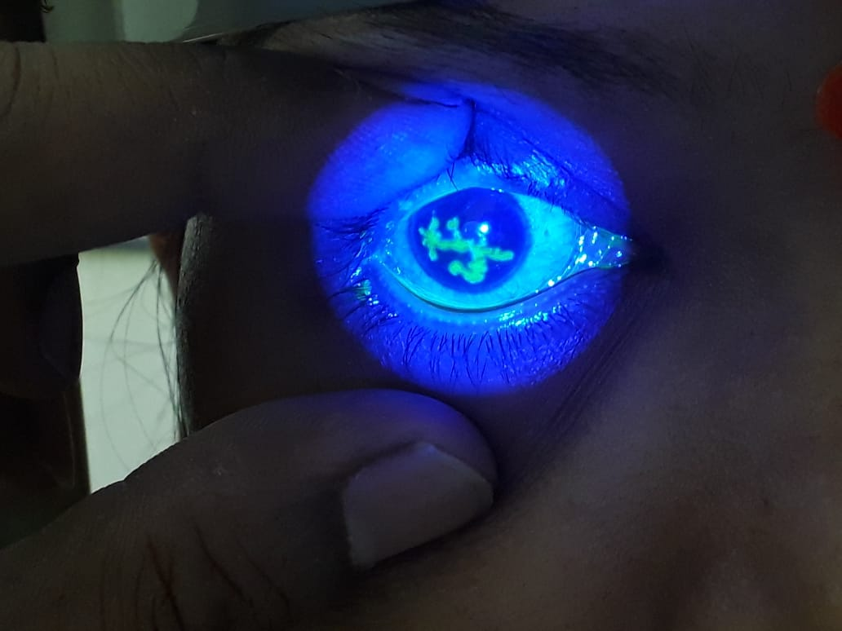

Slide 23
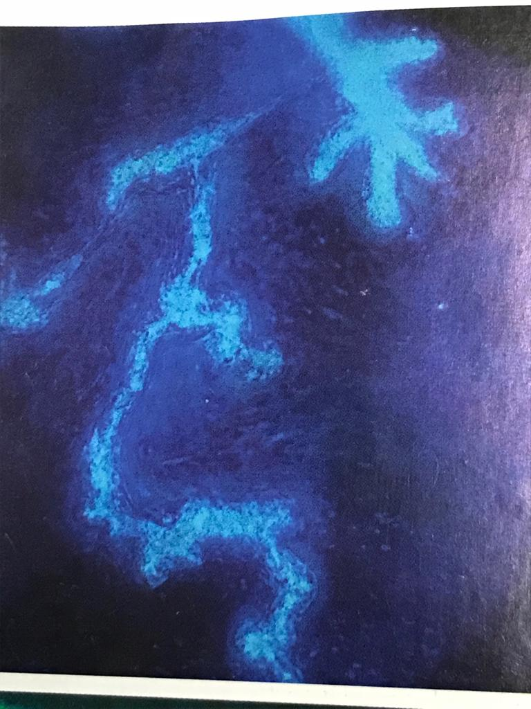

Slide 24
DENDRITIC ULCER
It is a typical lesion of recurrent epithelial keratitis
Ulcer is of irregular, zigzag,linear, dichotomous branching shape with terminal bulbs
The branches are generally knobbed at the ends

Slide 25
Floor of the ulcer stains with fluorescein and the virus laden cells at the margin take up rose Bengal
There is an associated marked diminution of corneal sensations
The borders consist of acantholytic infected cells and are slightly raised , grayish

Slide 26
Dendritic ulcer contd.
The central epithelial defect stains with fluorescein
On resolution , a dendritic shaped scar known as ghost dendrite may remain in the suerficial stroma

Slide 27
Geographical ulcer
The branches of dendritic ulcer enlarge and coalesce to form a large epithelial ulcer with a geographical or amoeboid configuration
The use of steroids in dendritic ulcer hastens the formation of geographical ulcer
Pts that are immunocompromised , on topical steroids or have long standind untreated ulcers can develop geographical ulcer

Slide 28
Marginal keratitis
These lesions are located near the limbus
Can resemble staphylococcal catarrhal ulcers.
Epithelial defect and lack of corneal sensation can help in diagnosis
More resistant to treatment they frequently become trophic ulcer

Slide 29
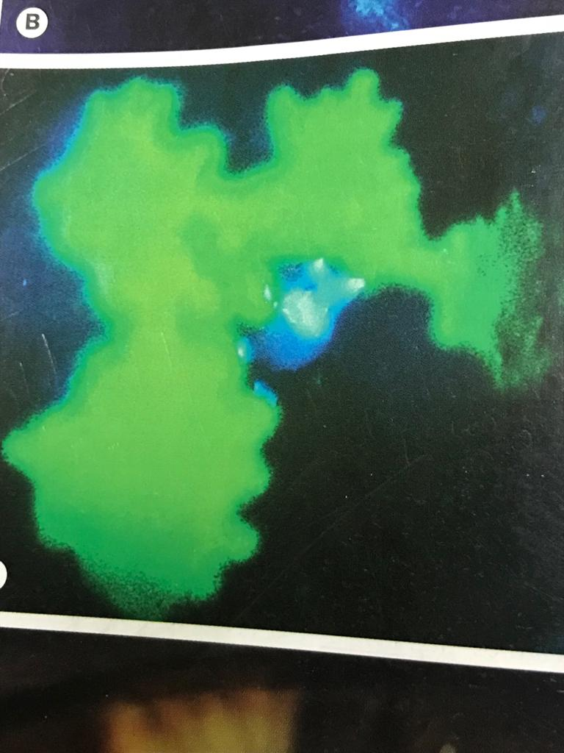

Slide 30
Metaherpetic (trophic) ulcer
Not associated with live virus
Result from inability of epithelium to heal
It is called trophic ulcer if it arises denovo and metaherpetic ulcer if it follows a dendritic or geographical ulcer

Slide 31
Causes are multifactorial and include toxicity from antiviral medications, poor tear surfacing, underlying lowq grade stromal inflammation
Neurotrophic ulcers start as roughened epithelium that breakdown to produce an epithelial defect with smooth margins
Borders are grayish and elevated

Slide 32
In contrast to geographic ulcers, rose Bengal stains the base of the ulcer while fluorescein stains the periphery and this is k/a reverse staining

Slide 33
Stromal/endothelial keratitis
Immune mediated response to non-replicating viral particles
Classified based on the predominant site and type of involvement
Endothelitis
Localised endothelitis
Diffuse vand linear endothelitis
Necrotising keratitis
Immune stromal keratitis
Keratouveitis

Slide 34
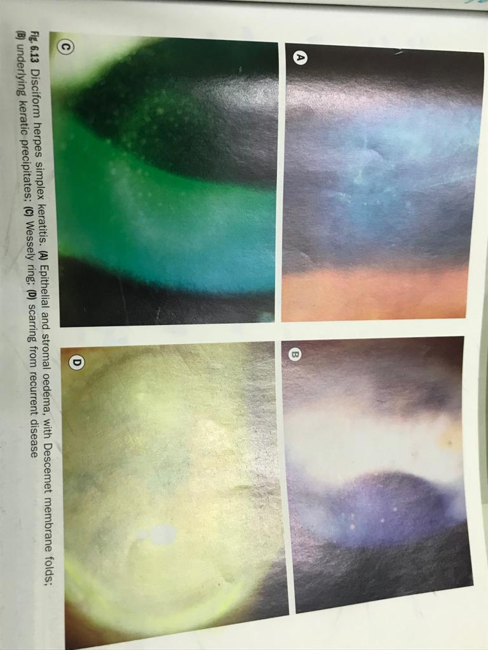

Slide 35
Epithelial Keratitis(dendritic or geographic)
SYMPTOMS
Mild to moderate discomfort
Redness
Photophobia
Watering
Blurred vision

Slide 36
Signs in epithelial keratitis
Swollen opaque epithelial cells arranged in a coarse punctate or stellate pattern
Central desquamation – result in linear branching ulcer(dendritic) mostly located centrally
Branches of the ulcer have characteristic terminal buds

Slide 37
Signs contd.
Corneal sensation is reduced
Inadvertent topical steroid treatment may promote progressive enlargement of dendritic ulcer to geographical ulcer.
Mild subepithelial haze is typical
Mild anterior chamber activity may be present

Slide 38
Follicular conjunctivitis may be associated
Vesicular eyelid lesions may be present
Elevated IOP
Persistent punctate epithelial erosions can be present following healing

Slide 39
Investigations
Pre-treatment scrapings can be sent in viral transport medium for culture
PCR
Giemsa staining shows multinucleated giant cells
Fluorescent Antibody Testing
Tzank smear
Serum antibody testing

Slide 40
6th study limitations:
1. many of trials had inadequate recruitment or high dropout rate
2. oral acyclovir in prevention trials was only used for 3 weeks
3.The corticosteroid regimen was standardised and not tailored to inflammation
4.TFT was used in both the study and placebo groups in all the therapeutic trials

Slide 41
D/D
Herpes zoster keratitis
Healing cornel abrasion(pseudodendrite)
Acanthamoeba keratitis
Epithelial rejection in a corneal graft
Tyrosinaemia type 2
Epihelial effect of soft contact lens

Slide 42
Treatment
Topical- acyclovir 3 % ointment and gancyclovir0.15% gel each admintered 5 times daily ,
Topical trifluridine can be given 9 times daily
Idoxuridine and vidarabine are older drugs (less effective and more toxic)

Slide 43
t/t contd.
Debridement – for resistant cases
Oral antiviral therapy- acyclovir 200-400 mg five times a day for 5-10 days , famciclovir, valacyclovir
Interferon monotherapy
Skin lesions – treated with acyclovir cream 5 times daily

Slide 44
t/t contd.
Cycloplegia – Homatropine 1% once or twice daily
IOP control- PROSTAGLANDINS MUST BE AVOIDED AS THEY PROMOTE HERPES VIRUS ACTIVITY AND INFLAMMATION GENERALLY
Topical steroids in case of disciform keratitis (endothelitis)

Slide 45
In refractory cases a combination of 2 topical agents with oral valacyclovir or famciclovir may be effective

Slide 46
Disciform keratitis
Aetiopathogenesis – controversial
It may be the result of active HSV infection of keratocytes or endothelium
It may be due to hypersensitivity reaction to viral antigen in the cornea

Slide 47
Clinical features
SYMPTOMS
Blurred vision
Discomfort
Redness

Slide 48
signs
A central zone of stromal oedema
Large KPs underlying the oedema
Folds in Descemet membrane in severe cases
WESSELY immune ring of deep stromal haze signifies deposition of viral antigen and host body complexes

Slide 49
Signs contd.
IOP may be elevated
Reduced corneal sensation
Healed lesions often have a faint ring of stromal and subepithelial opacification and thinning

Slide 50
t/t
INITIAL T/T
Topical steroids (prednisolone1% or dexamethasone 0.1%) with antiviral cover both 4 times daily
IOP should be monitored
Cycloplegics
Antibacterial prophylaxis

Slide 51
Subsequently PREDNISOLONE 0.5% once daily is usually a safe dose
With active epithelial ulceration- try to keep steroid intensity as low as possible for adequate effect, with more frequent antiviral regimen ( topical antiviral 5 times daily with steroids 2-3 times daily titrated acc. to signs of activity

Slide 52
Oral steroids are sometimes used in severe stromal inflammation and to reduce steroid induced viral replication
Topical Cyclosporine 0.05% may be useful, in presence of epithelial ulceration and to facilitate tapering of topical steroids such as in steroid related IOP elevation

Slide 53
Herpetic eye disease study(heds)
HEDS was undertaken to assess the effect of adding topical corticosteroids and acyclovir to conventional therapy with trifluridine
It was a prospective , randomised , placebo controlled , multicentre study divided into 6 trials- 3 therapeutic, 2 preventive and 1 cohort

Slide 54
Heds contd.
1. Herpes stromal keratitis , not on corticosteroid trial:
compared with a placebo group , pts receiving prednisolone phosphate drops had faster
resolution and fewer treatment failures
however delaying corticosteroid t/t did not affect the eventual visual outcome

Slide 55
heds
2. Herpes stromal keratitis , on Corticosteroid treatment
There was no apparent benefit in adding oral acyclovir to topical corticosyteroids and
trifluridine
However visual acuity improved over 6 months in more pts on acyclovir

Slide 56
heds
4.Herpes Simplex Virus Epithelial Keratitis Trial:
In the t/t of acute HSV epithelial keratitis with trifluridine , the addition of oral acyclovir
offered no additional benefit in preventing subsequent stromal keratitis or iritis

Slide 57
heds
3. Herpes Simplex Virus Iridocyclitis, Receiving topical corticosteroids
more t/t failure occurred in placebo group than in the acyclovir group, indicating a
potential benefit to adding oral acyclovirto to topical corticosteroids and antivirals

Slide 58
heds
6. Ocular HSV Recurrence Factor Study:
No association was found between psychological or other forms of stress and
HSV recurrences.
Previous episodes of epithelial keratitis were not a predictor for future occurences
while previous , especially multiple episodes of stromal keratitis markedly increased
the probability of subsequent stromal keratitis

Slide 59
heds
5. Acyclovir Prevention Trials:
oral acyclovir reduced the risk of any form of recurrent ocular herpes by 41% and
stromal keratitis by 50%
The risk of multiple recurrences decreased from 9% to 4%
However protection did not persist once acyclovir was discontinued

